Slide 1
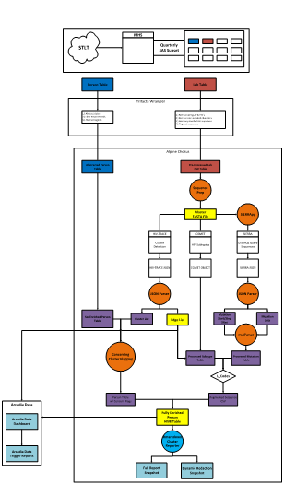
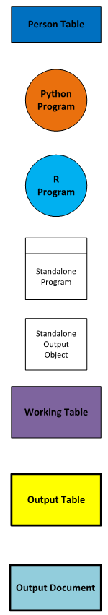
Molecular
HIV Surveillance
Python, R, standalone, and interactive applications all require testing
Live data is often unavailable, each stage can be properly vetted with the methods described
abstraction
cleaning
drug resistance
Cluster inference
subtyping
Cluster Growth Rate Analysis
Surveillance-Requested Stats and Metrics
Interactive
Dashboards
Cluster-level Reports

